Slide 1
PERCUTANEOUS MANAGEMENT OF MITRAL REGURGITATION
DR. HIMAL RAJ. M

Slide 2
INTRODUCTION
Severe mitral regurgitation - insidious disorder
Medical therapy relieves symptoms - not underlying mitral pathology
Surgical treatment for MR:
MVR MV repair (MVRe)
superior long-term outcomes

Slide 3
INTRODUCTION
Transcatheter MV therapies - slower development path -complex anatomy of MV and mitral apparatus
minimally invasive approaches – for elderly, severe LV dysfunction and significant comorbidities

Slide 4
CLASSIFICATION
Based on functional anatomy
groups devices into those targeting :
leaflets (percutaneous leaflet plication, percutaneous leaflet coaptation, percutaneous leaflet ablation)
annulus (indirect: coronary sinus approach or an asymmetrical approach; direct: true percutaneous or a hybrid approach)
chordae (percutaneous chordal implantation)
LV (percutaneous LV remodeling)

Slide 5
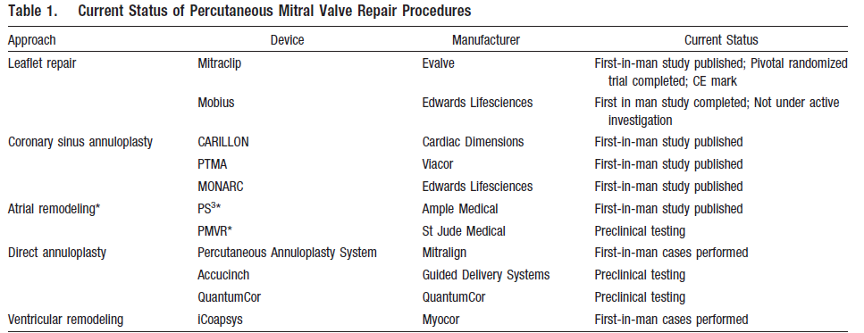
Circ Cardiovasc Intervent. 2009;2:140-146.)

Slide 6
Leaflet Repair - EDGE-TO-EDGE TECHNIQUE
1991- Alfieri et al - suturing leaflets together to reduce MR in degenerative MR (edge-to-edge leaflet repair)
Suturing anterior and posterior mitral leaflet edges near their midpoints double-orifice valve

Slide 8
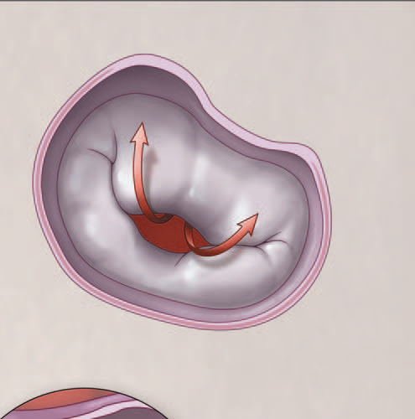
mmcts.2009.004002

Slide 9
key exclusion criteria
– Recent myocardial infarction
– Any interventional or surgical procedure within 30 days of the index procedure
– Mitral valve orifice area <4 cm2
– Renal insufficiency, endocarditis, rheumatic heart disease
mmcts.2009.004002

Slide 10
mmcts.2009.004002

Slide 13
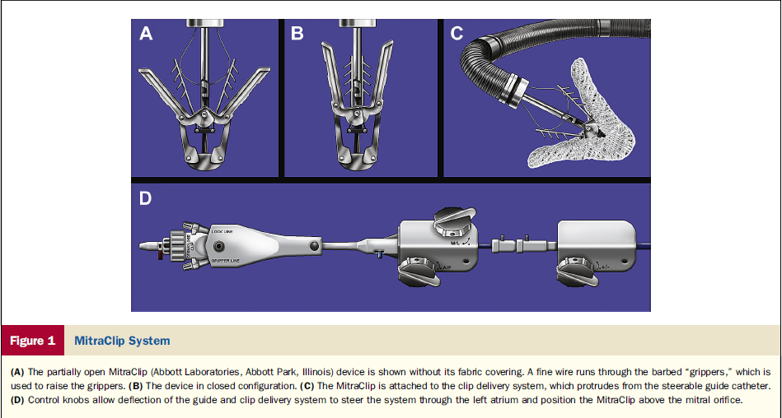

Slide 14
The MitraClip device - 4-mm-wide cobalt -chromium implant with two arms that are opened and closed with the use of the delivery-system handle.
The steerable guide catheter and clip delivery system (CDS) are advanced inside the 14 F – 16 F guide catheter.
Once the CDS is axially aligned perpendicularly above the line of coaptation of the mitral valve, the clip is opened to 180, the grippers are elevated and the CDS is oriented perpendicular to the free edge of the leaflets.

Slide 15
Data:
–EVEREST I: Feasibility study (n=55)
–EVEREST II: Randomized trial (n=279)
–REALISM: Registry
–ACCESS Europe: Registry
–TRAMI: Registry
–GRASP: Registry
–COAPT: Ongoing randomized study to study safety and efficacy
–RESHAPE-HF: Randomized study, clip vs. medical therapy

Slide 16
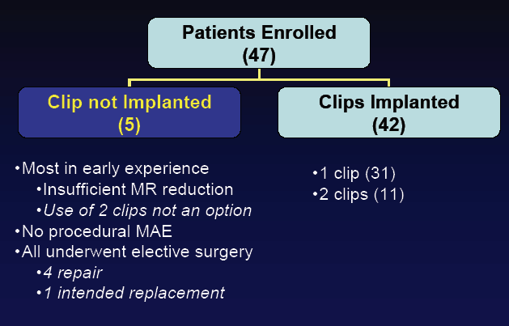
EVEREST I
Endovascular Valve Edge to edge REpair pair STudy

Slide 17
EVEREST II Study Design
Prospective, randomized, multicenter study
Control: surgical mitral valve repair/ replacement
Patients randomized 2:1
37 centers in US and Canada
Primary Effectiveness Endpoint
Freedom from surgery, death, and moderate to severe (3+) or severe (4+) mitral regurgitation at 12 months.
Primary Safety Endpoint
Freedom from MAE at one month

Slide 18
OUTCOMES
Randomly assigned 279 patients in a 2-to-1 ratio to undergo either percutaneous repair (184 patients) or mitral-valve surgery (95 patients) of mitral regurgitation
N Engl J Med 2011;364:1395-406

Slide 20
Conclusions from EVEREST II 4 Year Follow up
At 4 years - surgery remains the standard of care for treatment of MR among eligible patients.
Percutaneous repair -similar mortality and symptomatic improvement but higher rate of MR requiring repeat procedures
percutaneous repair - higher rate of residual MR at 1 year- no difference in later occurrence of MR or mitral valve intervention between 1-year and 4-year follow up

Slide 21
TRAMI (Transcatheter Mitral Valve Interventions) register - The German mitral register
Established in 2010 in order to assess the safety and efficacy of percutaneous mitral valve therapy in Germany
The TRAMI registry is the largest real world cohort of patients treated with MitraClip
Mitral Clip was found to be safe and established risk factors for conventional cardiac mitral valve surgery, such as advanced age (≥76 years), female gender, severely reduced LV-EF (<30%) and high logistic EuroScore(≥20%) were not predictive for mortality or major complication rates.

Slide 22
For whom is Mitra Clip Therapy?
Mitra clip can be considered as a new treatment option in the following cases:
Patients with primaryMR, severe LV dysfunction(LV-EF<30%) and relevant co-morbidities.
Symptomatic patients with severe secondaryMR, severe LV dysfunction(EF<30%) and no option for revascularization.
Symptomatic patients with severe secondaryMR with mild to moderate LV dysfunction (EF>30%), no option for revascularization and relevant co-morbidities.
high operative risk or are inoperable.
safe treatment option with low 30 day mortality

Slide 24
INDIRECT ANNULOPLASTY CS Approach (CS Reshaping)

Slide 25
A device placed in the coronary sinus to create tension that is transmitted to annulus.
Thus, the annular circumference is decreased and mitral leaflet coaptation improves.

Slide 26
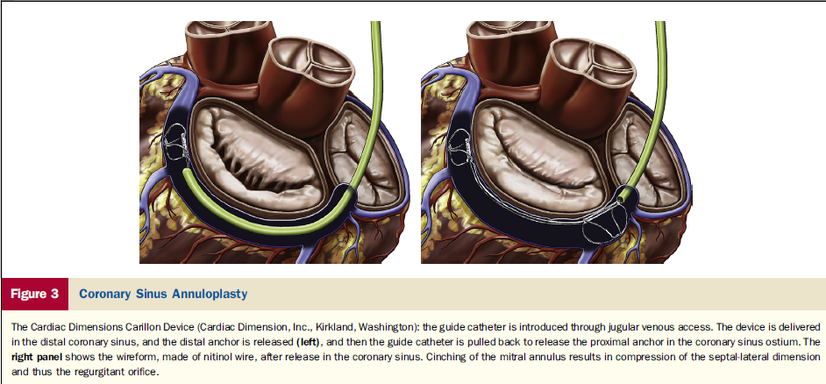

Slide 28
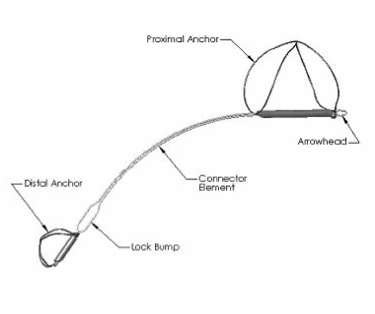
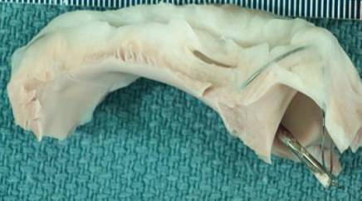
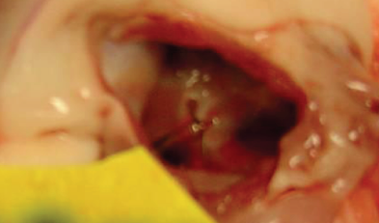
Carillon mitral contour system

Slide 29
Carillon Device Patient Selection
Patient Selection:
Moderate to severe FMR due to ischemic or non ischemic cardiomyopathy.
NYHA class II-IV
LV EF <40%
Dilated mitral annulus/insufficient coaptation length.
CRT candidates prior to CRT implant.
Stable heart failure medication for 3 months
Exclusion Criteria:
Primary mitral regurgitation.
Coronary artery disease requiring revascularization.
Presence of coronary sinus lead
Significant renal insufficiency (serum creatinine >2.2 mg/dl

Slide 30
Conclusions of AMADEUS Trial
Percutaneous placement of a mitral annuloplasty device based in the coronary sinus (CARILLON Mitral Contour System) has the potential to safely and significantly treat FMR in patients with heart failure with resultant symptomatic benefit

Slide 31
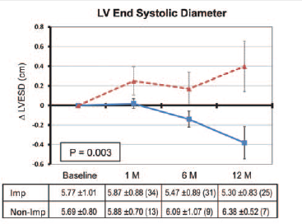
Circulation. 2009;120:326-333

Slide 32
Conclusions of TITAN Trial
This study demonstrates that percutaneous CS-based mitral annuloplasty can significantly and safely reduce functional MR severity in HF patients
There is significant LV reverse remodelling over 12 months and improved measures of clinical outcome over 24 months

Slide 34
The Viacor PTMA system uses 2 primary structural elements: a multilumen PTFE (Teflon) PTMA catheter and Nitinol (nickeltitanium alloy) PTMA treatment rods.
The Viacor 7F, 3-lumen PTMA diagnostic multilumen catheter was advanced over a 0.035-in guide wire through the CSG sheath and into the coronary sinus under fluoroscopic guidance.

Slide 39
Circ Cardiovasc Interv 2009;2;277-284

Slide 41
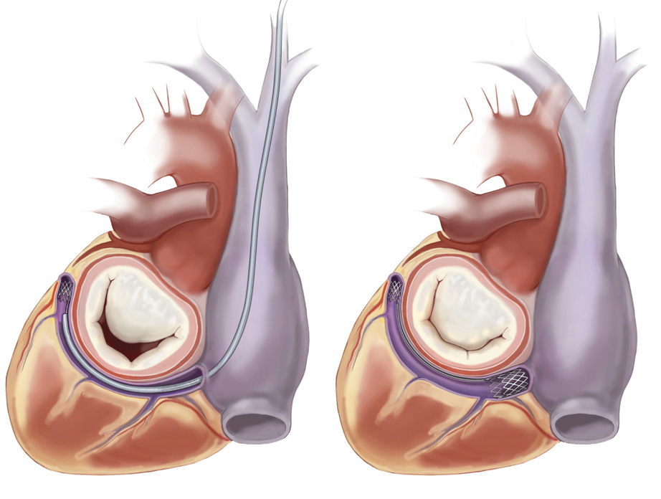
EVOLUTION Phase I Study
J Am Coll Cardiol Intv 2011;4:115–22

Slide 42
J Am Coll Cardiol Intv 2011;4:115–22

Slide 44
Device Name | Company Name | Trial | Technique | Current status
Carillon Mitral Contour | Cardiac Dimensions, Inc. | AMADEUS, TITAN, INTEGRAL, TITAN II | Indirect annuloplasty | Ongoing, CE
Monarc | Edwards Lifesciences | EVOLUTION I, EVOLUTION II | Indirect annuloplasty | Suspended
Viacor PTMA | Viacor, Inc. | PTOLEMY, PTOLEMY II | Indirect annuloplasty | Suspended
Mitral Cerclage Annuloplasty | National Institutes of Health | Animal study | Indirect annuloplasty | Animal model

Slide 45
Direct Annuloplasty

Slide 46
Percutaneous energy-mediated cinching approach to direct annuloplasty have included the following:
QuantumCor device
ReCor device –: high intensity focused ultrasound circumferentially

Slide 47
Catheterization and Cardiovascular Interventions
Volume 74, Issue 1, pages 43–48, 1 July 2009

Slide 49
Annuloplasty—Direct: Percutaneous Mechanical Cinching Approach

Slide 50
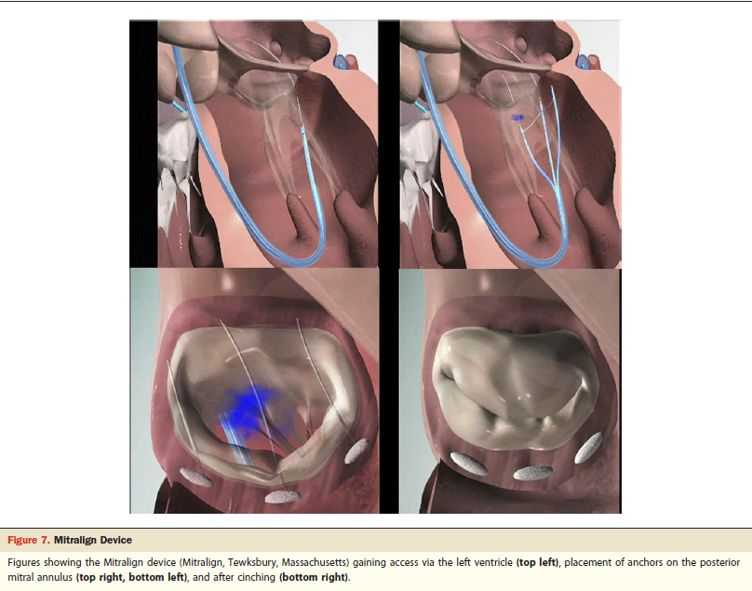

Slide 51
The Mitralign Percutaneous Annuloplasty System consists of the following devices:
Deflectable guide catheter
Crossing wire
“Bident” translational catheter
Pledget Delivery Catheter
Plication Lock Delivery Catheter

Slide 52
Femoral access (14 Fr.) approaching the posterior mitral annulus via the left ventricle
2 pairs of surgical pledgets are delivered to the posterior mitral annulus in the area of P1 and P3
Pledgets are pulled together (plicated) and locked
Potential to Customize Therapy:
Option to implant 1, 2 or 3 pairs of pledgets
Adjust the amount of plication to match the heart size or extent of mitral regurgitation
Target the location of the implant to match the MR jet

Slide 53
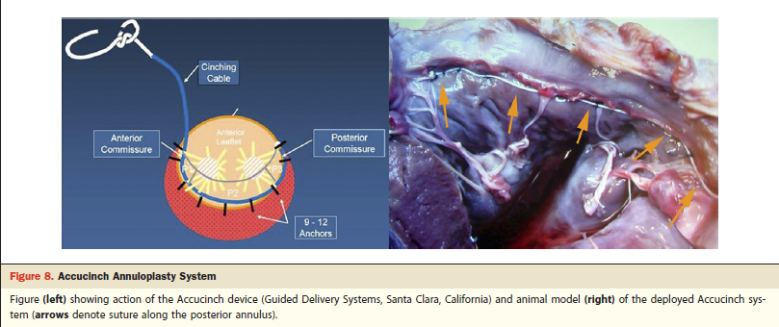

Slide 54
Annuloplasty—Direct: Hybrid Approach

Slide 56
Ventricular remodeling

Slide 57
reduce ventricular dilation by directly remodelingthe LV while also compressing the mitral annular septal-lateral dimension
Through a pericardial subxiphoid approach,2 epicardial pads connected by a flexible suture like cord placed on the LV surface
The cord is passed through the LV between the 2 papillary muscles, bisecting the ventricle.
Shortening of the cord reduces LV size in an anteroposterior dimension

Slide 58
Euro Intervention Supplements (2006) 1 (Supplement A)

Slide 59
Euro Intervention Supplements (2006) 1 (Supplement A)

Slide 60
RESTOR-MV TRIAL
significant sustained reductions in LV chamber dimensions and volume
Reduced MR
and improved survival- compared with mitral annuloplasty

Slide 61
Chordal repair

Slide 62
MitraFlex™
MitraFlex™ is a mitral valve repair system designed for direct thorascopic approach through the apex of a beating heart. The MitraFlex™ system performs the following functions on a beating heart:
Stabilization and centering of the mitral valve leaflets
Automatic capturing and connection of the approximate midpoint of the leaflets
Implantation of an artificial cordae tendonae that controls the movement of the valve leaflets and reduces the annulus thereby reducing or eliminating mitral valve regurgitation

Slide 63
Transcatheter Chordal Implants The MitraFlex device sheath (TransCardiac Therapeutics, Atlanta, Georgia) (top left), clip for leaflet plication (top middle), and artificial chord implantation (top right); the NeoChord device (Neochord, Inc., Minnetonka, Minnesota) implanted from a transapical approach (middle); the Babic device (bottom).

Slide 64
Percutaneous MV Replacement
early stages
Replacement devices for direct left atrial, antegrade, transseptal and apical delivery being tested in bench and pre-clinical models
small number of patients

Slide 65
CURRENT GUIDELINES
Nishimura, RA et al.
2014 AHA/ACC Valvular Heart Disease Guideline

Slide 66
The percutaneous mitral clip procedure may be considered in patients with symptomatic severe secondary MR despite optimal medical therapy (including CRT if indicated)
who fulfil the echo criteria of eligibility
are judged inoperable or at high surgical risk by a team of cardiologists and cardiac surgeons and
who have a life expectancy greater than 1 year (recommendation class IIb,level of evidence C).
ESC 2012

Slide 67
CONCLUSION
The different percutaneous methods are in their different phases of evolution with few already out of race due to unacceptable practical problems.
As the experience will grow, there will be improvement in both the design of the devices and the competence of the operators.
different techniques have to be used in combination to offer an effective and long lasting solution.

Slide 68
THANK YOU

